Slide 1

Developing a Web Application with integrated Recommendation Systems
DIPLOMA THESIS
Author: Darida Razvan Alexandru
Supervisor: lect. dr. Lupsa Dana
Notes:
NOTĂ:
Pentru a modifica imaginea de pe acest diapozitiv, selectați-o și ștergeți-o. Apoi faceți clic pe pictograma Imagini din substituent pentru a insera propria imagine.

Slide 2

Content
The aim of the thesis
General theory
Application
Conclusions

Slide 3
The aim of thesis
creating a full stack web application for ordering books
implementing a recommendation system within the site
different ways of implementation for the recommendation system
approaching different ways of analyzing the results
comparing the results on two data sets

Slide 4

Recommendation Systems
is a very specific type of Machine Learning that anticipates a user’s rating or preference for an item.
are used even in search engines
are responsible for a huge portion of the modern economy

Slide 5
Types of data
Explicit data
Implicit data
Explicit feedback means asking the user to provide feedback on the content presented to them.
This can also be represented in the form of :
likes
dislikes
star reviews
Implicit feedback looks at the things users do on websites anyhow
Interpret them as indications of interest or disinterest.
Time spent
Clicks
Purchases

Slide 6

Top-N Recommendations
the system offers a finite list of the best things to present to a given user.
the recommendation system rates every book
it gives back the top N books after sorting them

Slide 7
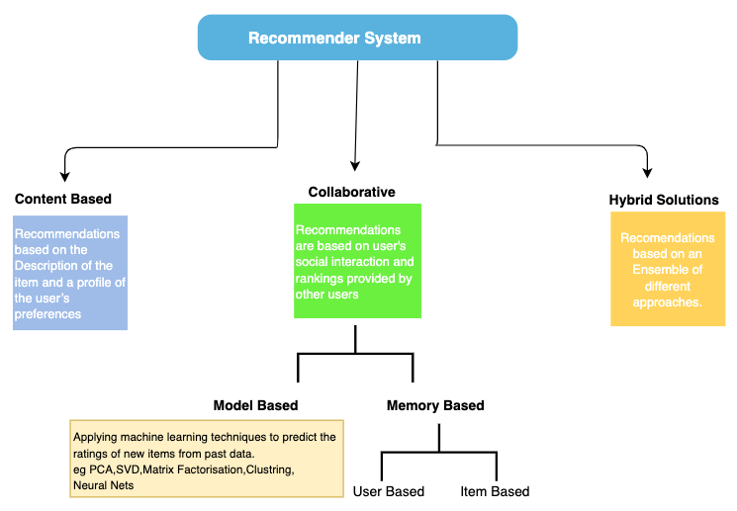
Recommender System

Slide 8
Analyzing results
Mean Absolute Error(MAE)
Root Mean square error(RMSE)
Diversity
Hit rate (HR)
Cumulative hit rate (cHR)
Average Reciprocal Hit Rate(ARHR)
Coverage
Novelty

Slide 9

Front-end - React
free and open-source front-end JavaScript library for building website
a declarative programming language
reusable components
uses Hooks to solve a wide variety of seemingly unconnected problems in React

Slide 10



Back-end - Flask
Python-based microweb framework
does not necessitate the usage of any specific tools or libraries.
object relational mapping(ORM) that is integrated in SQL Alchemy

Slide 11
Application details - Architecture
Front-End
Back-End
Component based architecture
Suitable for building software based on reusable components
built on dividing a user interface into a collection of manageable (reusable) parts that then are used to create a result (page or app screen)
Layered architecture
One of the most common architectural styles
modules or components with similar functionalities are organized into horizontal layers
each layer performs a specific role within the application

Slide 12
Conclusions

Slide 13
Conclusions
A recommendation system for books based on the reviews left by users
The system considers all the reviews left from the user getting the recommendation
The system gives a top 10 list of books
The books would be best fitting for the user
All based on what other users with similar tastes reviewed

Slide 14
Conclusions
Also 5 different Recommendation Systems algorithms were implemented:
SVD,
SVD++,
ItemKNN,
UserKNN,
RBM.
The algorithms were tested and compared:
on the data set of the web application BookStore
on the 100.000 movie data set
In order too see how they perform based on different metrics

Slide 15

Thank you!

